Slide 1

Mo Patel
Director, Artificial Intelligence
Think Big Analytics
Recommendation Systems
Wide & Deep – part 2
Beyond Search

Slide 2
Agenda
Introduction to recommendation systems
Traditional recommendation approaches
Introduction to Wide & Deep
Wide Learning in context of Wide & Deep
Deep Learning Fundamentals
Deep Learning for Recommendations
Preparing Data for Wide & Deep
Training Wide & Deep models
Serving Wide & Deep models
Champion-Challenger Approach to deployment
Tuning Wide & Deep models
Wrap-up and Summary
Notes:
Now we will cover a few fundamentals from Deep Learning approaches and how they apply to Wide & Deep and the recommendations engine use cases in particular.

Slide 3
author Nikhil Buduma
published: June 2017
Notes:
An excellent reference was recenlty published by O’Reilly.
. In this practical book, author Nikhil Buduma provides examples and clear explanations to guide you through major concepts of this complicated field.
Along with a basic understanding of machine learning, this book will get you started.
Examine the foundations of machine learning and neural networks
Learn how to train feed-forward neural networks
Use TensorFlow to implement your first neural network
Manage problems that arise as you begin to make networks deeper
Build neural networks that analyze complex images
Perform effective dimensionality reduction using autoencoders
Dive deep into sequence analysis to examine language
Understand the fundamentals of reinforcement learning

Slide 4
Wide & Deep
Notes:
Recall that memorization and generalization are both important for recommender systems. We had a brief look at memorization in the context of Wide & Deep. Now let’s cover a few deep learning fundamentals.
With the reinvigoration of neural networks, both research and implementation, in the 2000s, deep learning has become an extremely active area, and is paving the way for modern machine learning. Large companies like Google, Microsoft, Facebook, and Teradata have taken notice and are actively growing in-house deep learning teams. Deep learning is still a pretty complex and diffiuclt subject to grasp. But we are making progress.

Slide 5
Wide & Deep
Notes:
The human brain is the most incredible biological system we know. It dictates the way we perceive every sight, sound, smell, taste, and touch. It enables us to store memories, experience emotions, fashion communication, innovate, create, and dream. Without it we would be primative organisms, incapable of anything beyond simple reflective actions.
A human infant brain only weighs a single pound. But somehow it solves problems that even the most sophisticated supercomputers still find to be impossible. Within a few months after birth, infants can recognize the faces of their parents, discern discrete objects from their backgrounds, and even tell voices apart.
Within a year a human infant has already developed an intuition for natural physics, can track objects even when they become partially or completely blocked, and can associate sounds with specific meanings. By early childhood a sophisticated understanding of grammar and vocabularies of thousands of words are attained.

Slide 6
Wide & Deep
Notes:
The foundational unit of the human brain is the neuron. A tiny piece of brain matter, about the size of a grain of rice, contains over 10,000 neurons, each of which forms an average of 6,000 connections with other neurons. It is this massive biological network that enables us to experience the world around us. For our purposes in Deep Learning, our goal is to building machine learning models to solve problems in an analogous manner.
At its core the neuron is optimized to receive information from other neurons, process the information in a unizue way, and send the results to other cells.

Slide 7
Wide & Deep
Inputs
Strengths
Sum
Transform
Output
Notes:
The neuron receives its inputs along antennae-like structures called dendrites. Each of the incoming connections is dynamically strengthened on weakened based on how often it is used. This is how we learn new concepts. The strength of each connection determines the contribution of the input to the neuron’s output. After being weighted by the strength of their respective connections, the inputs are summed together in the cell body. THis sum is then transformed into a new signal that’s then propagated along the cell’s axion and sent off to other neurons.

Slide 8
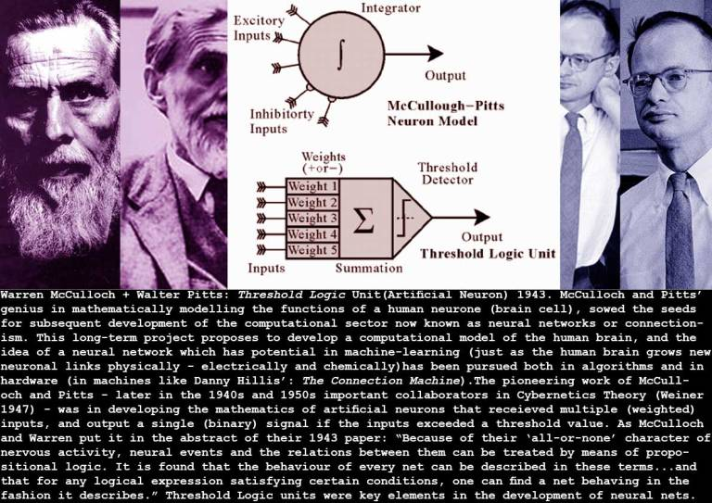
Wide & Deep
Notes:
For decades, years before Turning published his seminal paper on Machine Intelligence, we have dreamed of building intelligent machines with brains like ours. In 1943 an approach first pioneered by Warren S. McCulloch and Walter H. Pitts gave us a plausible starting point. Describing neuronal activity as a connected series of functions, it becamse possible to imagine building artificial neurons. But building these artificially intelligent machines requires us to solve some of the most complex computational problems we have ever attempted. The field of Deep Learning would lead us there.

Slide 9
Wide & Deep
The perceptron
Inputs
Strengths
Sum
Transform
Output
Notes:
Based on McCulloch/Pitts work, the perceptron algorithm dates back to the late 1950s; its first implementation, in custom hardware, was one of the first artificial neural networks to be produced. The perceptron is a linear classifier, therefore it will never get to the state with all the input vectors classified correctly if the training set D is not linearly separable, i.e. if the positive examples can not be separated from the negative examples by a hyperplane. In this case, no "approximate" solution will be gradually approached under the standard learning algorithm, but instead learning will fail completely. Hence, if linear separability of the training set is not known a priori, one of the training variants below should be used.
But if the training set is linearly separable, then the perceptron is guaranteed to converge, and there is an upper bound on the number of times the perceptron will adjust its weights during the training.
Marvin Minsky’s and Seymour Papert’s 1969 book, Perceptrons, demonstrated various-—even trivial—limitations, inadvertently leading to a decline of interest within both academia and the general public, who had mistakenly assumed computer software would simply keep up with the breakneck pace of computational power.

Slide 10
Wide & Deep
The artificial neuron
Inputs
Strengths
Sum
Transform
Output
Notes:
After the early promise and disfavor of the perceptron, als based on McCulloch/Pitts, we can translate the functional understanding of human neurons into an artificial model that we can represent more completely in our systems. Just as in biological neurons, our artificial neuron takes in some number of inputs, x1, x2 ... and so on, each of which is multiplied by a specific weight, w1, w2, and so on. These weighted inputs are, as with biology, summed together to produce the logit of the neuron.

Slide 11
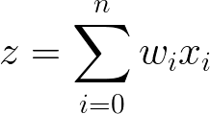
Wide & Deep
Inputs
Strengths
Sum
Transform
Output
Notes:
In many cases the logit also includes a bias, which is a constant, which is not shown in the formula. The logit is then passed through a function (f) to produce the couput. This output can then be transmitted to other neurons.

Slide 12
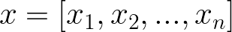
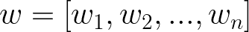
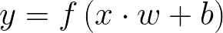
Wide & Deep
Inputs
Strengths
Sum
Transform
Output
Notes:
By re-expressing the functionality of our neuron in vector form, it is more useful. Let’s reformulate the inputs as a vector x and above and the weights of the neuron as the vector w. Then we can express the output of the nuron as y = f(x . w + b) where b is the bias term. In other words, we can compute the output by performing the dot product of the input and weight vectors, adding in the bias term to produce the logit, and then apply the transformation function. While this may seem trivial, thinking about our neurons ad a series of vector manipulations will be crucial to how we implement them.

Slide 13
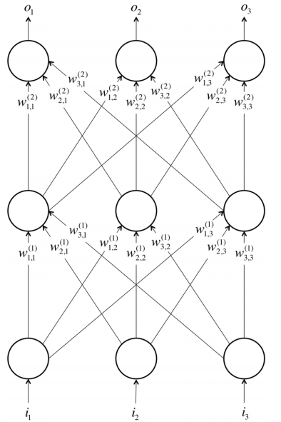
Wide & Deep
Feed-Forward Neural Networks
Notes:
Although single neurons are more powerful than linear perceptrons, neurons are still not nearly expressive enough to solve complicated learning problems. There is a reason our brain is made of more than one neuron. For example, it is impossible for a single neuron to differentiate handwritten digits. So to tackle much more complicated tasks, we will have to take our machine learning model further.
The neurons in the human brain are organized in layers. In fact, the human cerebral cortex is made up of six layers. Information flows from one layer to another until sensory input is converted into conceptual understanding. Let’s take vsion. The bottommost layer of the visual cortex receives raw visual data from our eyes. This information is processed by each layer and passed on to the next until, in the sixth layer, we conclude whether we are looking at a cat, or a ham sandwich or an airplane. Here we see a more simplified version of these layers.
Borrowing from these concepts we can construct an artificial neural network. A neural network emerges when we start hooking up neurons to each other, the input data, and to the output nodes, which correspond to the network’s answer to a learning problem. This is similar to the architecture described by McCulloch/Pitts in 1943. The bottom layer of neurons pulls in the input data. The top layer computes the final answer. The middle laer(s) are called hidden layers.

Slide 14
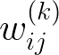
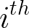
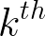
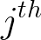
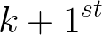

Wide & Deep
Let the weight
be the weight of the connection between the
neuron in the
layer with the
neuron in the
layer.
Parameter
vector:
Feed-Forward Neural Networks
Notes:
We let w(k)ij be the weight of the connection between the i-th neuron in the k-th layer, with the j-th neuron –n the k+1st layer. These weights constitute our parameter vector (Theta), and just as before, our ability to solve problems with neural networks depends on finding the optimal values to plug into Theta.

Slide 15
Wide & Deep
Feed-Forward Neural Networks
Note:
Connections only traverse from a lower layer to a higher layer.
There are no connections between neurons in the same layer.
No connections transmit from higher to lower.
Notes:
We start by discussing feed-forward networks because they are the simplest to analyze. More complicated connextivities will be addressed later. Keep in mind:
1) Layer of neurons that lie sandwiched between the input layer and the output layer are called hidded layers. This is where most of the magic happens.
2) Hidden layers enable automated feature extraction
3) It is not uncommon for hidden layers to have fewer neurons than the input layer to force the network to learn compressed representations of the original input.
4) It is not required that every neuron has its output connected to the inputs of all neurons in the next layer. In fact, selecting which neurons to connect to which other in the next layer is an art that comes from experience.
5) The inputs and outputs are vectorized representations of original data.

Slide 16
Wide & Deep
Inputs
Strengths
Sum
Transform
Output
Notes:
With Theta as our parameter vector established there are several valid choices for an activation function.

Slide 17
Wide & Deep
Activation Functions
A step function is a function was used by the original Perceptron. The output is a certain value, A1, if the input sum is above a certain threshold and A0 if the input sum is below a certain threshold. The values used by the Perceptron were A1 = 1 and A0 = 0.
Notes:
These kinds of step activation functions are useful for binary classification schemes. In other words, when we want to classify an input pattern into one of two groups, we can use a binary classifier with a step activation function. Another use for this would be to create a set of small feature identifiers. Each identifier would be a small network that would output a 1 if a particular input feature is present, and a 0 otherwise. Combining multiple feature detectors into a single network would allow a very complicated clustering or classification problem to be solved.

Slide 18
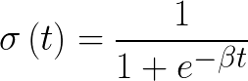
Wide & Deep
Activation Functions
A log-sigmoid function, also known as a logistic function, is given by the relationship:
Notes:
Where β is a slope parameter. This is called the log-sigmoid because a sigmoid can also be constructed using the hyperbolic tangent function instead of this relation, in which case it would be called a tan-sigmoid. Here, we will refer to the log-sigmoid as simply “sigmoid”. The sigmoid has the property of being similar to the step function, but with the addition of a region of uncertainty. Sigmoid functions in this respect are very similar to the input-output relationships of biological neurons, although not exactly the same. Above is the graph of a sigmoid function.

Slide 19
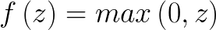
Wide & Deep
Activation Functions
A different kind of nonlinearity is used by the restricted linear unit (ReLU) neuron. The characteristic hockey stick shaped response results from:
Notes:
The ReLU has recently become the neuron of choice for many tasks, especially in computer vision, for a number of reasons despite some drawbacks.

Slide 20
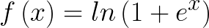
Wide & Deep
Activation Functions
Softplus is the differential surrogate of ReLU:
Notes:
Both the ReLU and Softplus are largely similar, except near 0 where the softplus is enticingly smooth and differentiable. In deep learning, computing the activation function and its derivative is as frequent as addition and subtraction in arithmetic. By switching to ReLU, the forward and backward passes are much faster while retaining the non-linear nature of the activation function required for deep neural networks to be useful.

Slide 21
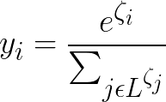
Wide & Deep
Activation Functions
The softmax activation function is useful predominantly in the output layer of a clustering system. Softmax functions convert a raw value into a posterior probability. This provides a measure of certainty. The softmax activation function is given as:
Notes:
Softmax is generalization of the logistic function. The output of the softmax function can be used to represent a categorical distribution. L is the set of neurons in the output layer. Often we want our output vectors to be a probability distribution over a set of mutually exclusive labels. Consider a neural network that we would train to recognize hand-written digits. Each label (0 through 9) is mutually exclusive, but it is highly unlikely we will be able to recognize digits with 100% confidence. Using a probability distribution gives us a better idea of how confident we are in our predictions. This is achieved by using a special output layer we call the softmax layer. Unlike other kinds of layers the output of a neuron in a softmax layer depends on the outputs of all the other neurons in its own layer. This is because we require the sum of all the outputs to be equal to 1. Letting Zi be the logit of the i-th softmax neuron, we can achieve this normailzation by setting its output as formulated above. A strong prediction would have a single entry in the vector close to 1, while the remaining entries were close to 0. A weak prediction would have multiple possible labels that are more or less equally likely.

Slide 22
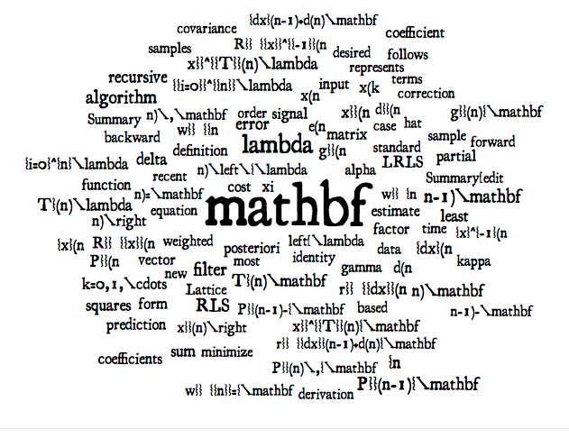
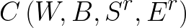
Wide & Deep
Cost Functions
A cost function is a measure of "how good" a neural network did with respect to it's given training sample and the expected output. It also may depend on variables such as weights and biases.
Notes:
A cost function is a measure of "how good" a neural network did with respect to it's given training sample compared to the expected output. It also may depend on variables such as weights and biases.
A cost function is a single value, not a vector, because it rates how good the neural network did as a whole.
Specifically, a cost function is of the form above where W is our neural network's weights, B is our neural network's biases, Sr is the input of a single training sample, and Er is the desired output of that training sample. Note this function can also potentially be dependent on output from other neurons.
A variety of cost functions have been used. The cost function measures what is actually important and meaningful for our purposes to the learning algorithm. As a result, we must choose, or accurately define, the cost function based on an understanding of the problem we want to solve or the level of achievement we want to reach. Cost functions include algorithms like mean squared error, alternative least squares, cross-entropy cost, exponential cost, Hellinger distance, and a slew of other. We will see results from cost functions when we evaluate the models we produce.

Slide 23
Wide & Deep
Gradient Descent
Gradient descent is a first-order iterative optimization algorithm for finding the minimum of a function. To find a local minimum of a function using gradient descent, one takes steps proportional to the negative of the gradient (or of the approximate gradient) of the function at the current point.
Notes:
Because part of the process of machine learning is to find the highest accuracy of predictions, or to minimize the error rate, given a set of training data, we must have tools to measure our models. Gradient descent is used to find the minimum error by minimizing the rsults of the cost function we employ.
Gradient descent is a first-order iterative optimization algorithm for finding the minimum of a function. To find a local minimum of a function using gradient descent, we take steps proportional to the negative of the gradient (or of the approximate gradient) of the function at the current point. Although there are other tools we might employ when it comes to optimization and error minimization, Gradient Descent is common and widely used in Machine Learning today.

